Slide 1


Charles Kwakye, Tristan Van Loy, Syan Delbart, Wieland Vandebotermet, Lucas De Greef, Jen Verboven
Project 4.0

Slide 2
Transforming Governance through Digital Solutions
Empowering the Public Sector

Slide 3

Mission and Vision
Driving Digital Transformation in the public sector

Slide 4



Core Values
Domains
Goals
Customer centric, Integrity and Accountability, and Innovation and Excellence
IT Services
Payroll and HR Services
Empowering the Public Sector with Comprehensive Digital Tools

Slide 5
Clientele & active sectors
Local authorities (285 municipalities)
Building apps for HR
Civil affairs, birth, marriage, funerals, construction, tax
Notes:
Maybe remove this slide or move the contents to a different one to

Slide 6


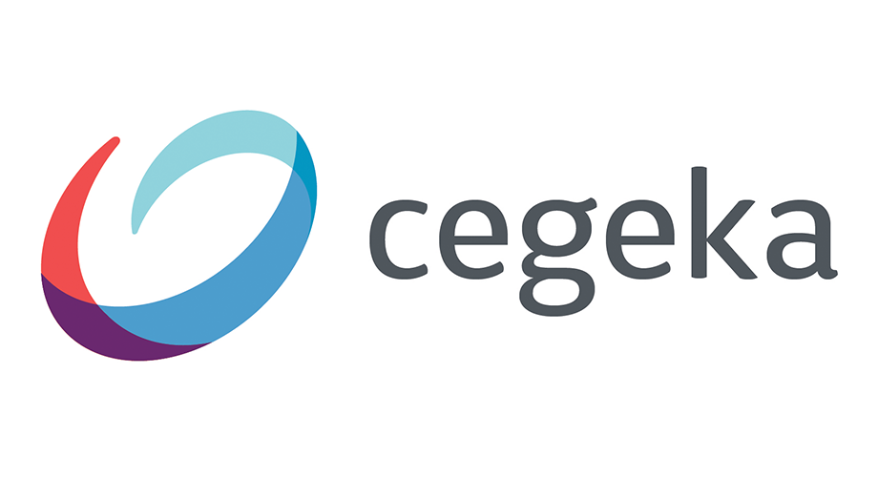
Smartville Partners

Slide 7
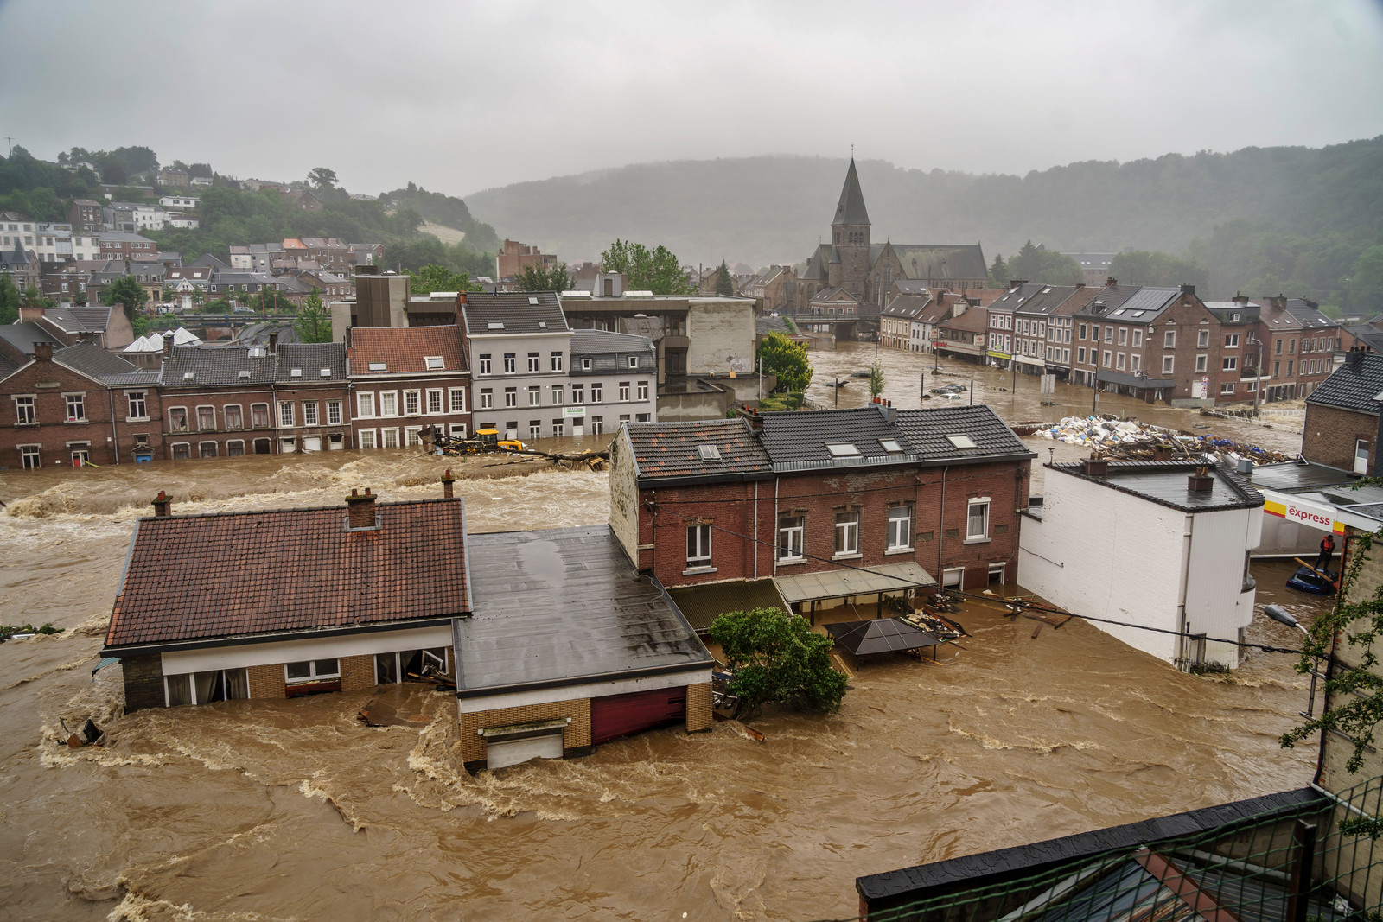
The problem?
The weather has become increasingly volatile, causing more floods.
Communication between parties is difficult and slow
data is decentralized.
Decision making and taking of measures in crisis situations is slow and could be more accurate

Slide 8
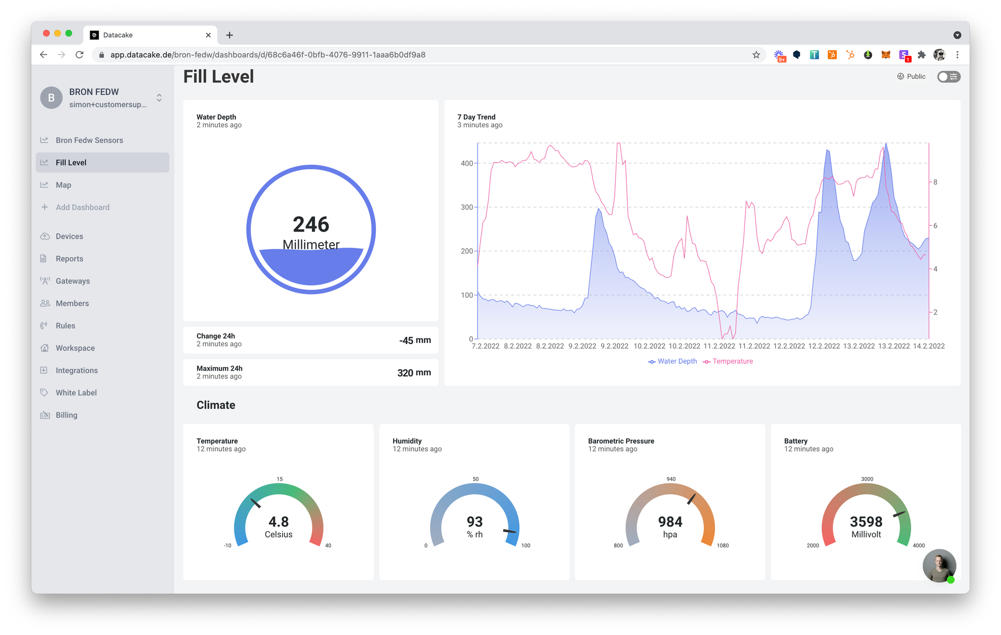
The solution?
Make a dashboard where data about second grade water streams is centralized and normalized
Improve decision making speed and accuracy of local authorities

Slide 9
Tech Requirements
Sensor
Data
Platform
My CSN

Slide 10
Existing data of water levels in second grade watercourses is either not normalized or missing
Interactions between infrastructures aren't always clear
Impact of decisions made or measures taken by governments isn't always clear
Crisis situations change very fast
The Difficulties

Slide 11
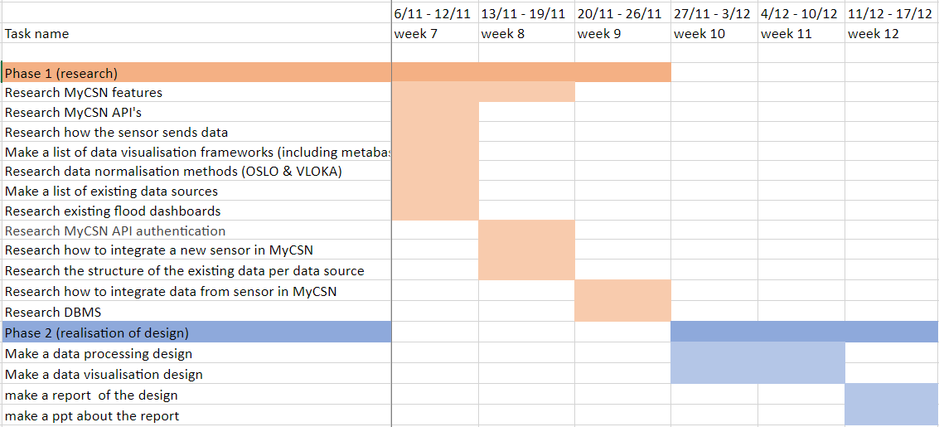
Project timeline

Slide 12
Information and reporting
Our responsibilities
1.1 Identification of Needs
We would evaluate the current project status to identify potential gaps in information,
1.2 Interview and Information Timeline
Define a schedule for additional interviews or data collection with team and client.
Project lead - Syan Delbart
Documents manager - Charles Nana Kwakye
2. Reporting to the Client
The team would establish a reporting schedule for client updates.

Slide 13
Project scope and risk analysis
Our responsibilities
We should integrate the project with the MyCSN platform
  Do good research to ensure we understand the platform
The visualization must take non-technical people in mind
  Do regular user testing, as to have an objective view to the usability
Not finishing the project on time
  A good planning

Slide 14
Project scope and risk analysis
PRODUCT OWNER responsibilities
The users need to have authorization to the dashboard.
  Make clear to those who need access and how they can access the dashboard

Slide 15
What Our Solution could DO and won't do
PRoDUct CapaBILities
Could have | Won't have
Dashboard using front-end framework | No prediction of floods

Slide 16
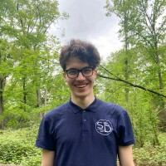
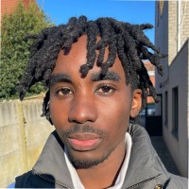
Meet the TeaM
Syan Delbart: Team leader, Digital Innovation. Competent in building Web Apps, Websites and Databases.
Charles Kwakye: Document lead, Artificial Intelligence. Data Visualization, Webscrapers and Websites.

Slide 17
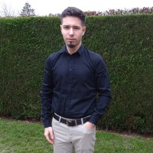
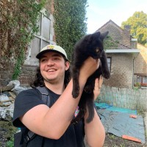
Meet the TeaM
Lucas De Greef: Team member, Internet of Things. Competent with PLC systems, APIs and sensors.
Tristan Van Loy: Team member, Cloud and cyber security. Competent in building and maintaining of cloud systems and security.

Slide 18
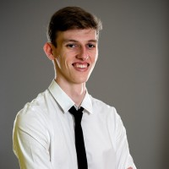
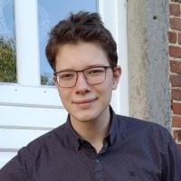
Meet the TeaM
Jen Verboven: Team member, Application development. Competent in building websites and web applications.
Wieland Vandebotermet: Team member, Application development. Competent in building and maintaining of web applications.

Slide 19

Thank You

