Slide 1
Code Craftsmen A1
Syan Delbart, Tristan Van Loy, Wieland Vandebotermet, Lucas De Greef, Jen Verboven, Charles Kwakye
Notes:
Syan

Slide 2
Meet the Team
Notes:
Syan

Slide 3
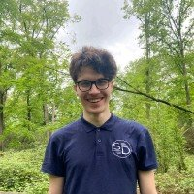

Syan Delbart
Charles Kwakye
Digital Innovation
Artificial intelligence
Notes:
Syan

Slide 4
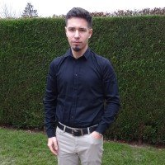

Lucas De Greef
Tristan van Loy
Internet of Things
Cloud and Cyber Security
Notes:
Syan

Slide 5
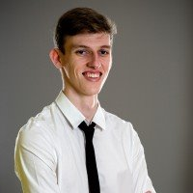
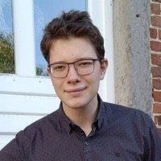
Jen Verboven
Wieland Vandebotermet
Application Development
Application Development
Notes:
Syan

Slide 6
The client
Notes:
Syan

Slide 7

Empowering the Public Sector
Notes:
Syan

Slide 8

Mission and Vision
Driving Digital Transformation in the public sector
Notes:
Syan

Slide 9
Project description
Notes:
Syan

Slide 10
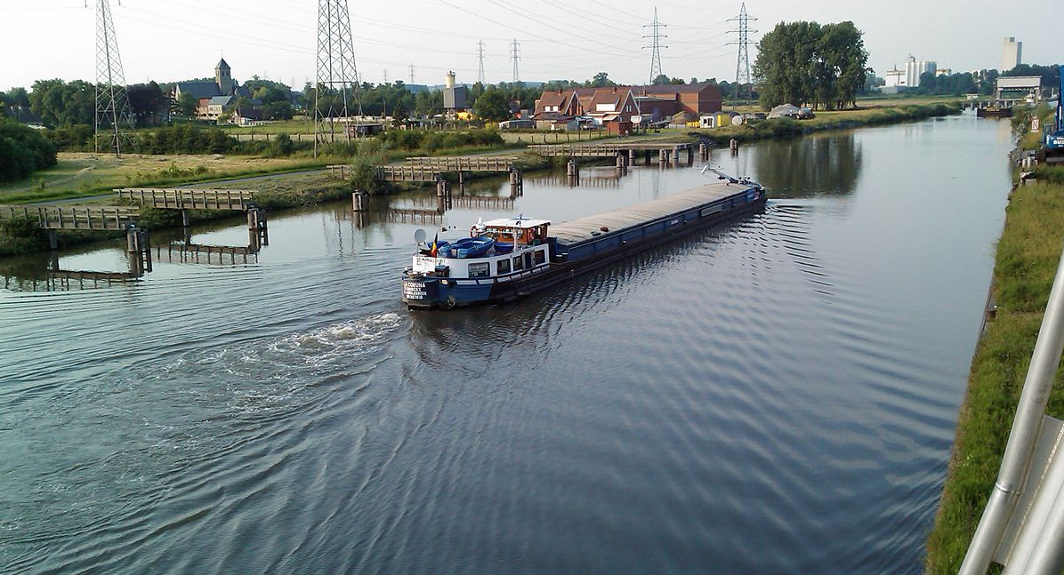
provide governments on the provincial level with a platform to monitor the water levels of second grade water streams
Notes:
Syan

Slide 11
Scope
Notes:
Syan

Slide 12
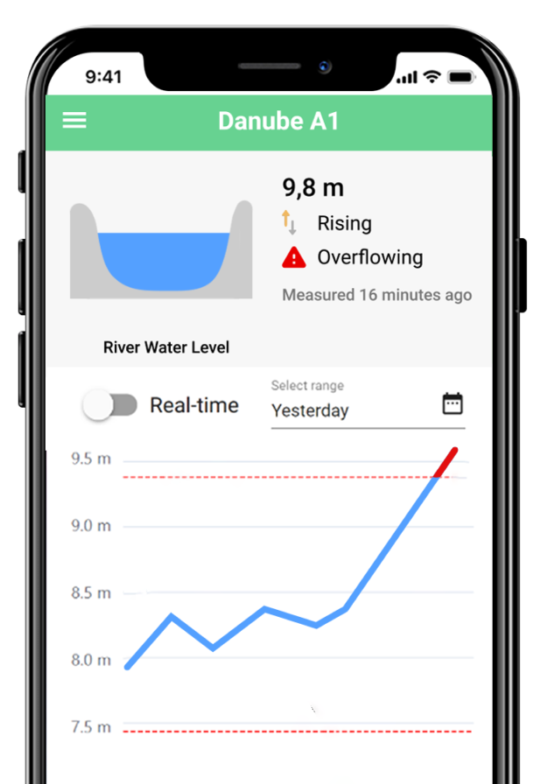
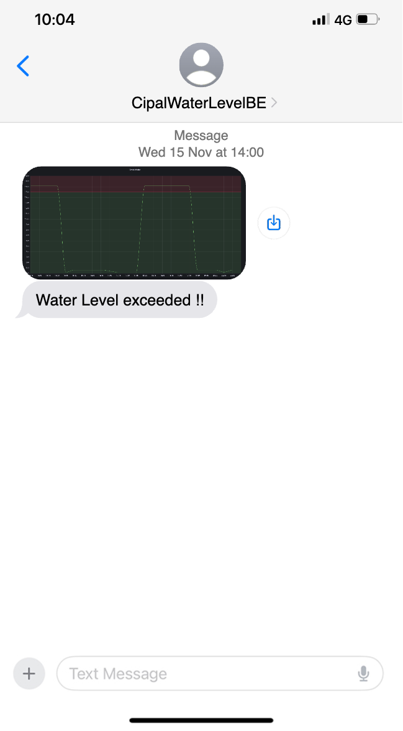
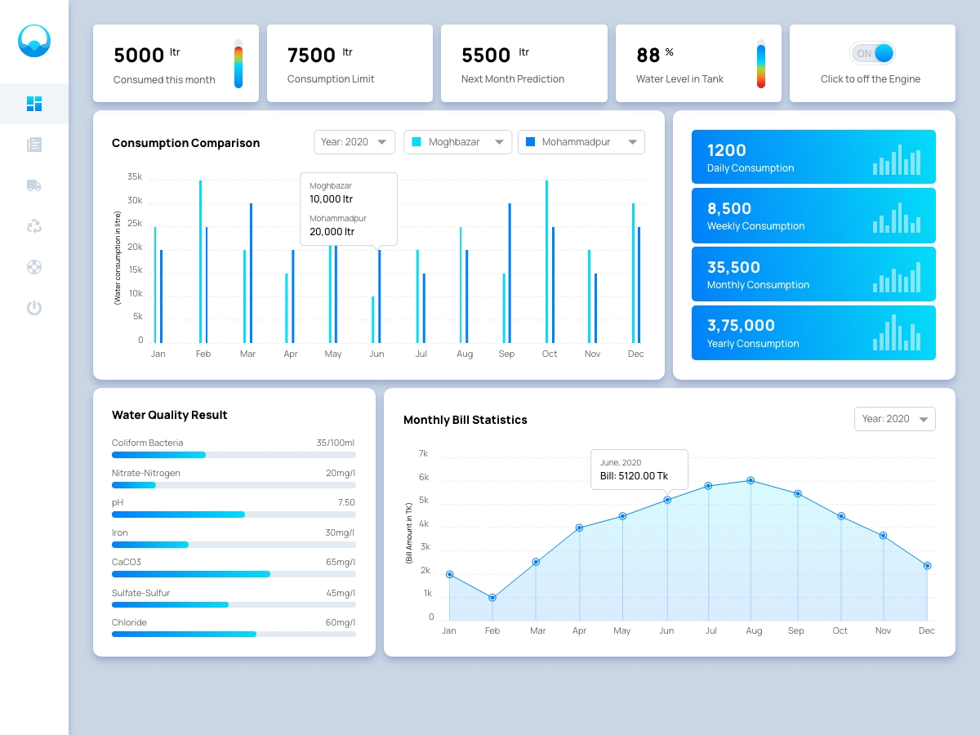
Could Have
Desktop App for admins
Mobile App
SMS Alerts
Notes:
Syan

Slide 13
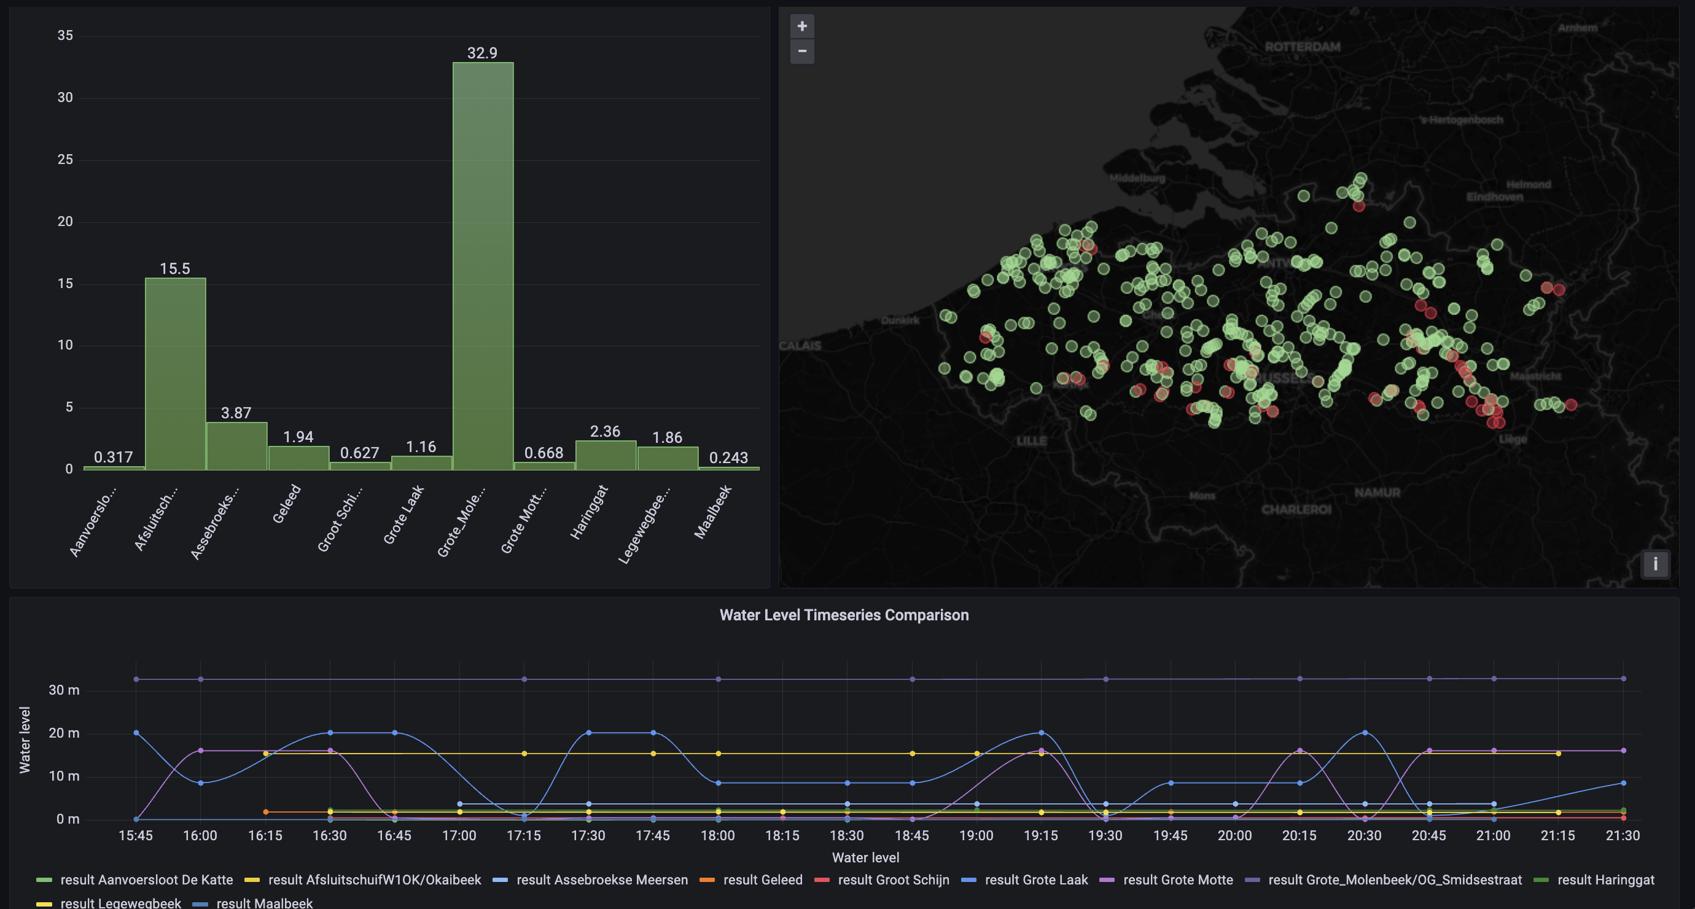
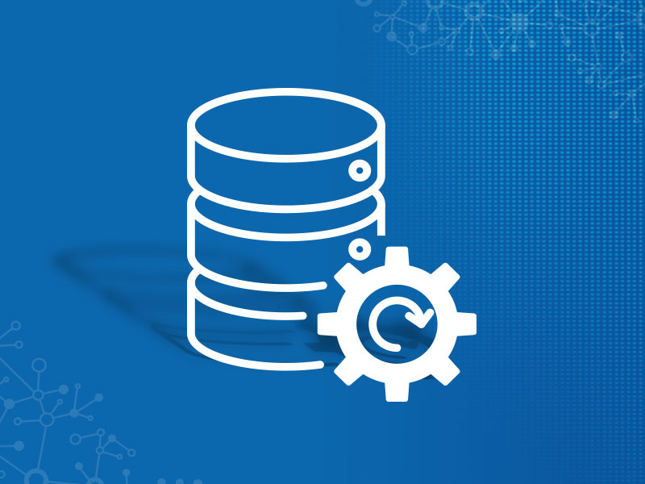


Should Have
Water Level Dashboard
Database
Server
Data backup
Notes:
Syan

Slide 14
Technology used
Notes:
Tristan

Slide 15







Technologies used
NextJS
PostgreSQL
AWS S3
Notes:
Tristan

Slide 16
Sensor
Notes:
Tristan

Slide 17
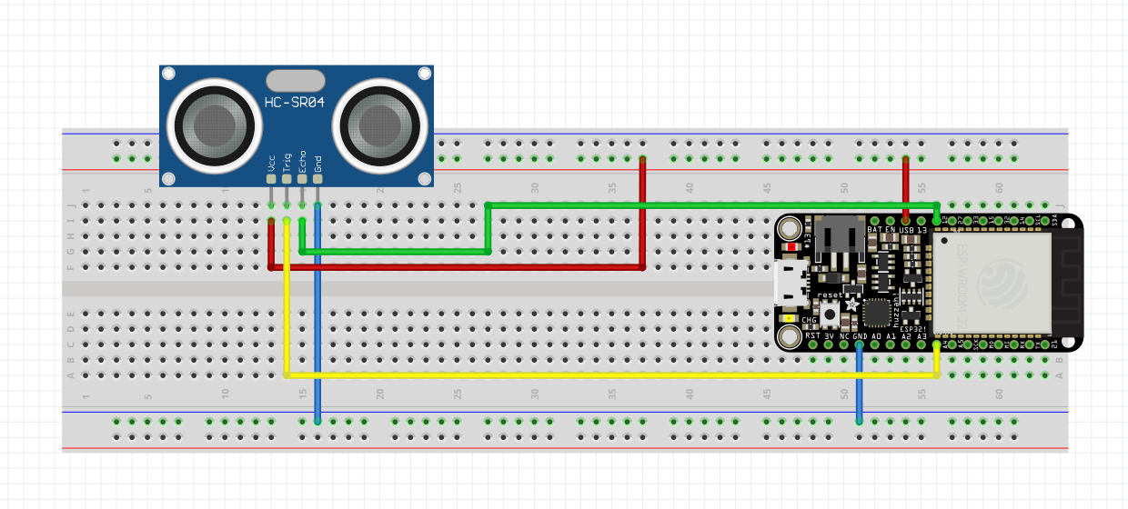
Schematic DIY sensor
Notes:
Tristan

Slide 18
DIY sensor
Arduino
Sends JSON data
MQTT
Notes:
Tristan

Slide 19
Architecture
Notes:
Tristan

Slide 20
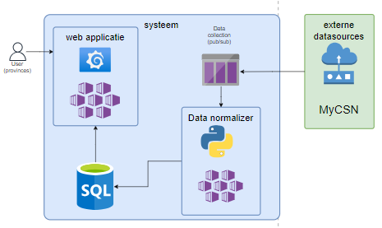
Notes:
Tristan

Slide 21
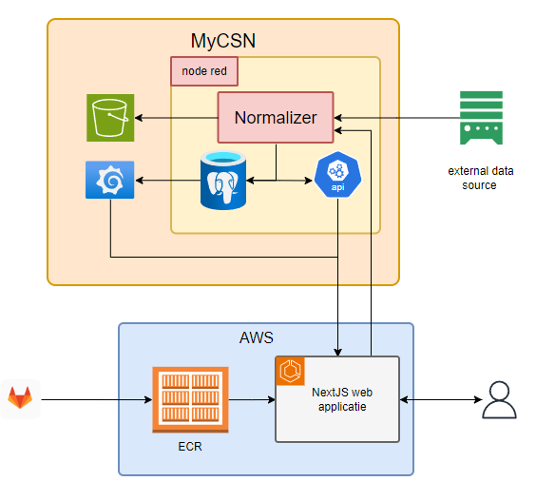
Notes:
Tristan

Slide 22
Deployment
Notes:
Tristan

Slide 23
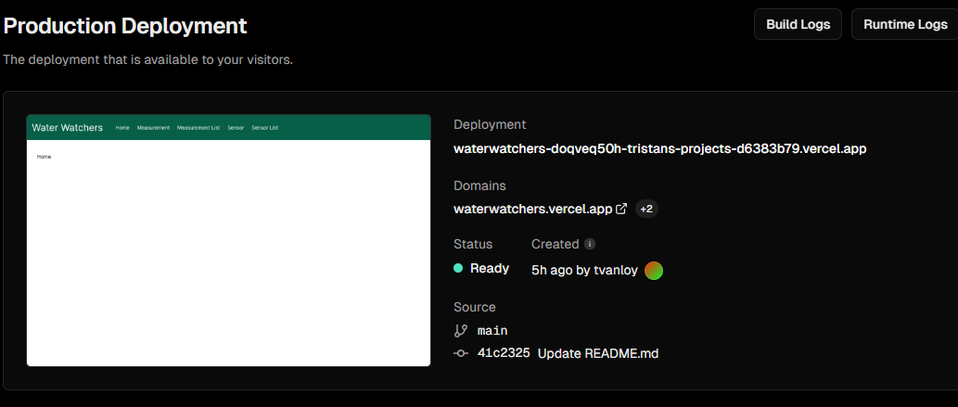
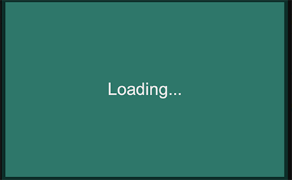
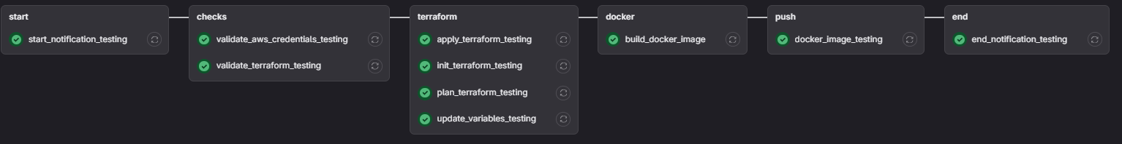
Deployment
On AWS
GitLab pipeline
For testing purposes on Vercel
Automatic deployment with GitHub
Notes:
Tristan

Slide 24
Node Red & data flow
Notes:
Jen

Slide 25
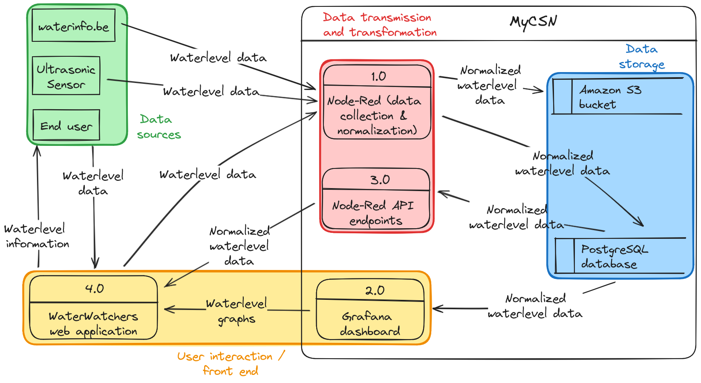
Elements
Notes:
Jen

Slide 26
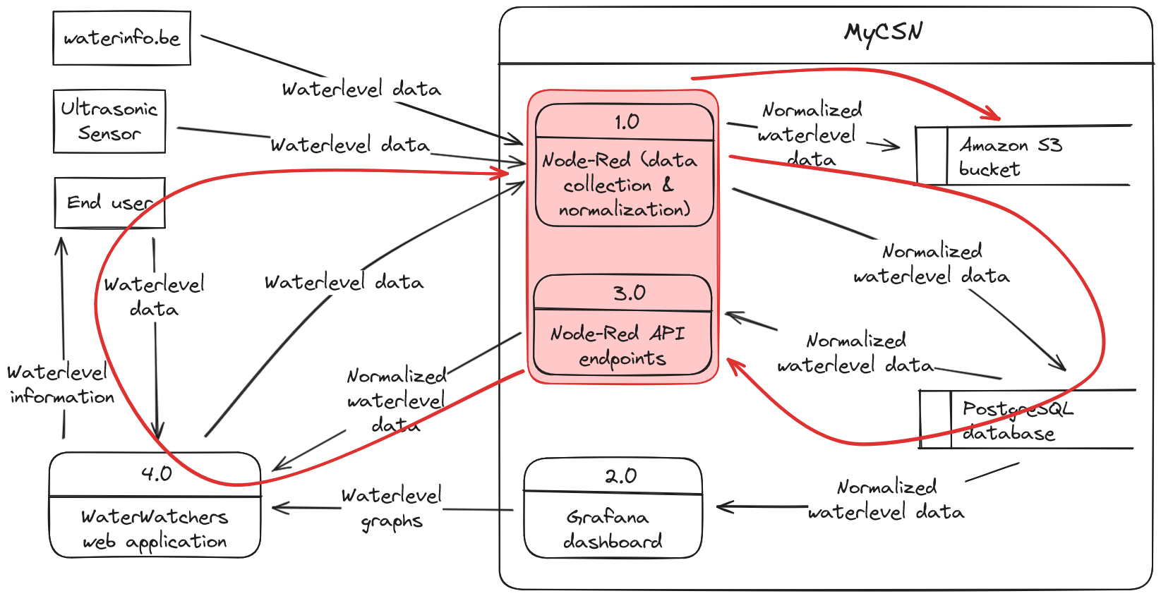
Heart of the solution
Notes:
Jen

Slide 27
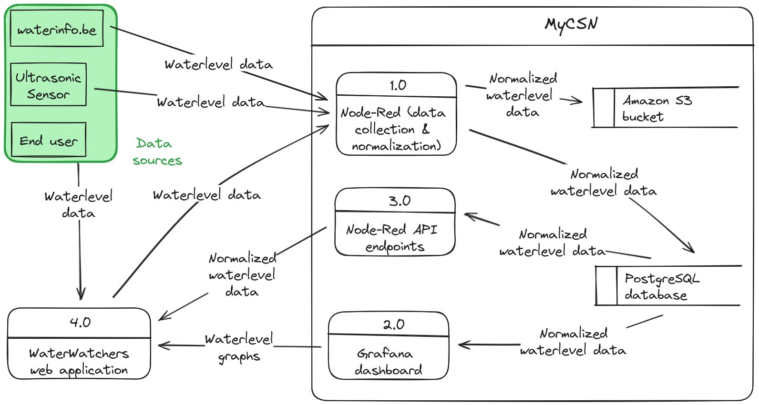
Elements
Notes:
Jen

Slide 28


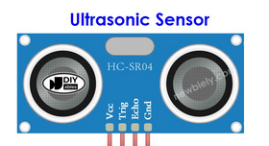
Data sources
Web
application
HTTP methods
HTTP request
HTTP responses
HTTP response
User
Input
MQTT connection
End user
Notes:
Jen

Slide 29
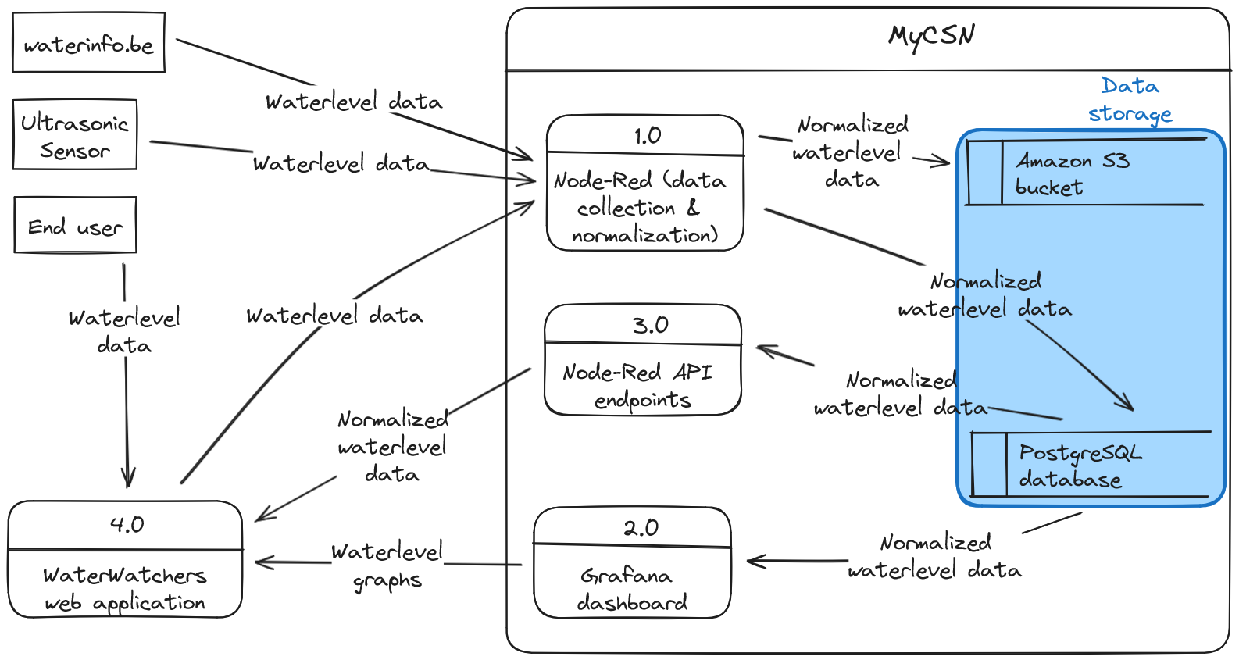
Elements
Notes:
Jen

Slide 30
Data storage
Postgressql
Standardized
data
Aws S3
OSLO standardized
data
Notes:
Jen

Slide 31
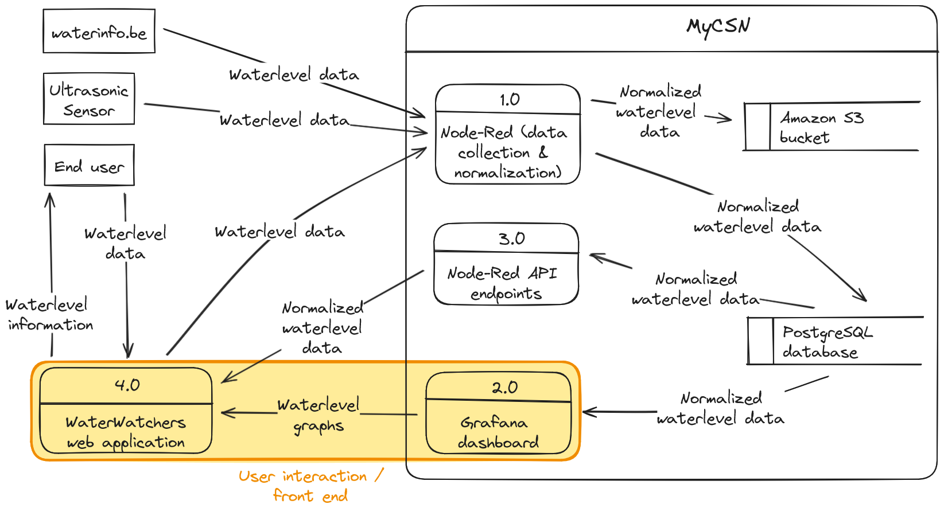
Elements
Notes:
Jen

Slide 32
Data storage
Standardized
data
Postgressql
Graphs
Web
application
Standardized
data
Standardized
data
API
methods
Notes:
Jen

Slide 33
Showcase

Slide 34
Strong points & points for improvement
Notes:
Jen

Slide 35
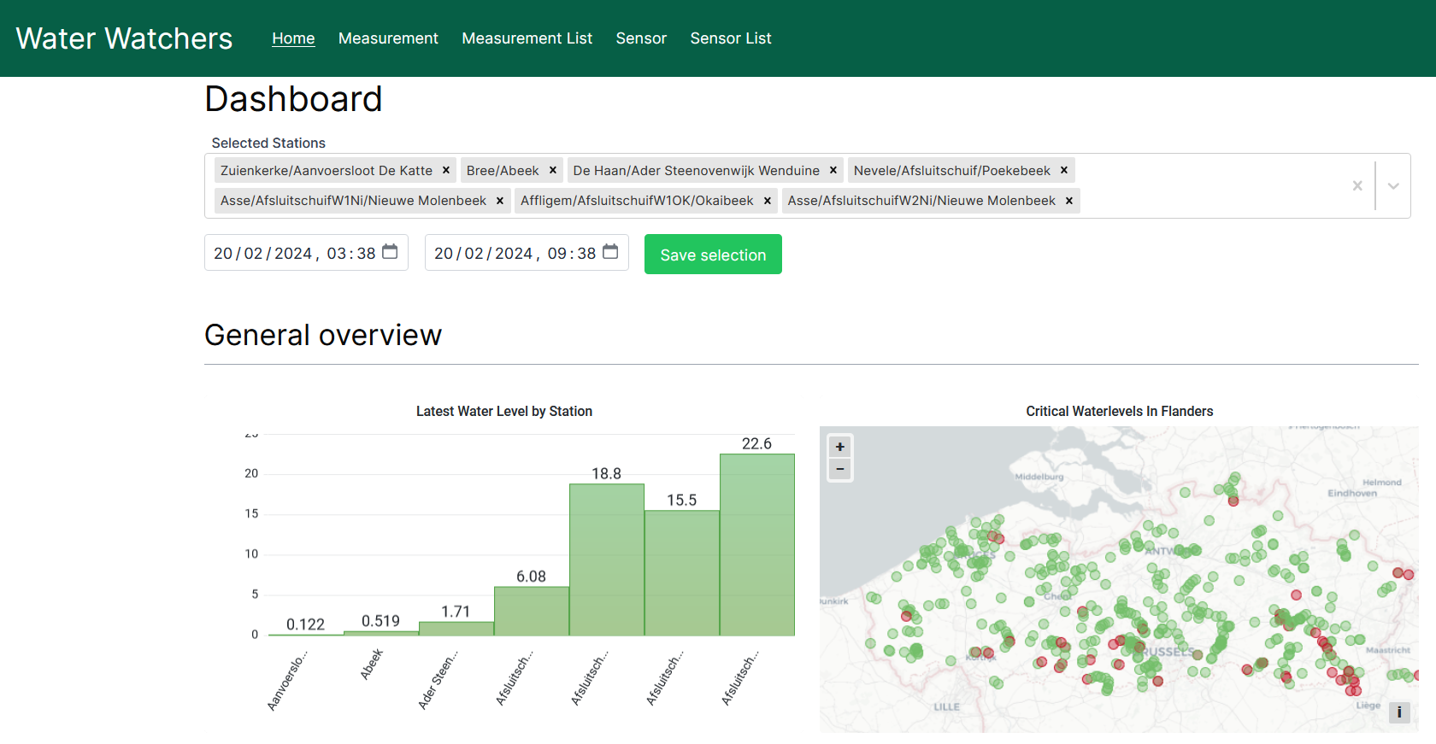
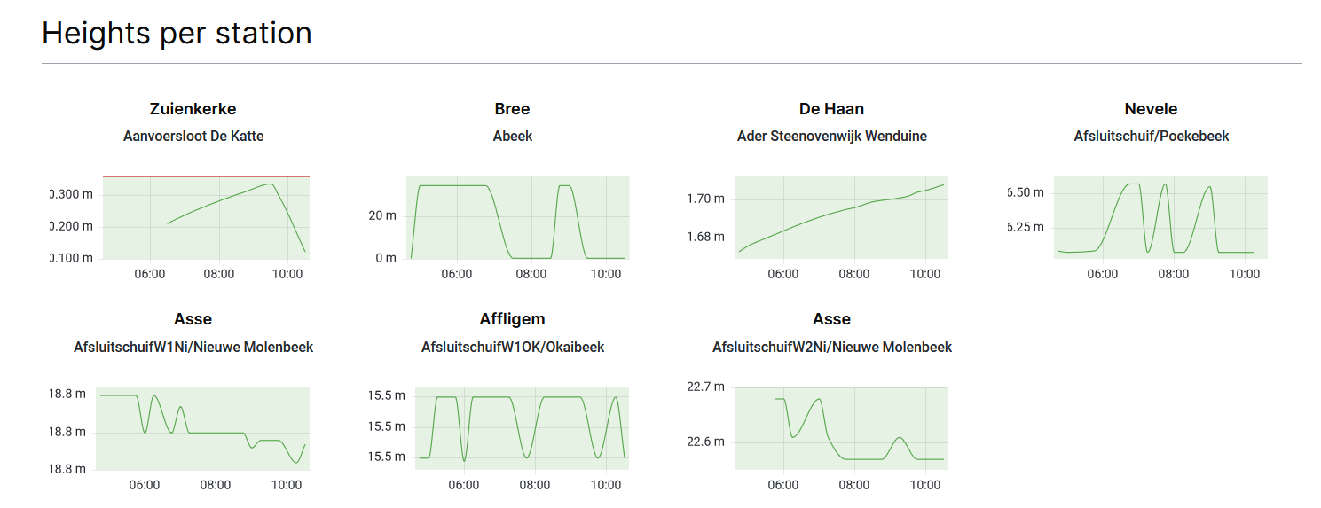

Slide 36
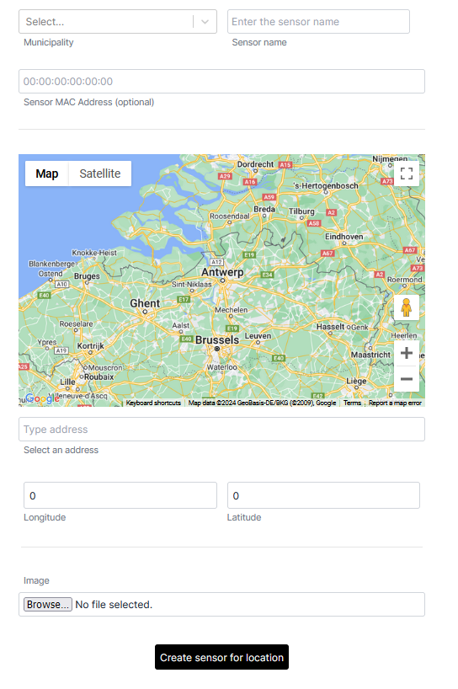
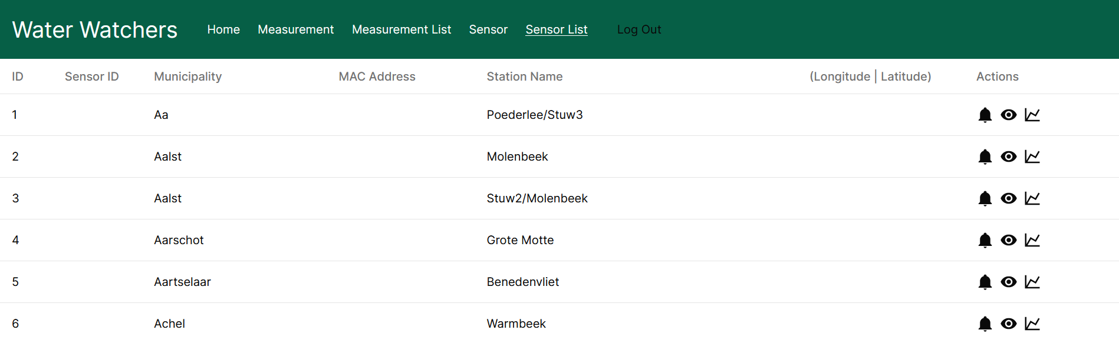

Slide 37
Retrospective
Notes:
Jen

Slide 38



Technical content
Implementation in broad project
Align with and understand
other
professions
Interpret other people's work
Notes:
Jen

Slide 39




Soft skills
Resolve each others' problems
Quickly delegate work
Feedback on others' work
Openness and communication
Notes:
Jen

Slide 40
Conclusion
Notes:
Jen

Slide 41
Questions?
Notes:
Jen

Slide 42
Screens Web App

Slide 43
Notes:
Syan

Slide 45
