Slide 1

Machine Learning Project
Belgian Motor Insurance
Claim Severity Prediction
End-to-End Machine Learning Pipeline for Individual Claim Accuracy
70,791
Random Forest
Insurance Records
Best Model
2026
MLflow Tracking
Hugging Face Hub
Streamlit Cloud

Slide 2
Navigation
Agenda
01
Project Overview
02
System Architecture
Business challenge, solution approach, and project objectives for insurance claim prediction
End-to-end pipeline design from data ingestion to production deployment
03
Dataset & Features
04
ML Pipeline
Belgian MTPL insurance data characteristics and engineered features
Seven regression models trained with comprehensive comparison methodology
05
Model Performance
06
Production Deployment
Detailed metrics comparison and Random Forest selection rationale
MLOps stack with Hugging Face Hub and Streamlit Cloud infrastructure
Key Insight: Random Forest selected for lowest MAPE (40.53%) on individual claim predictions

Slide 3
01 • Project Overview
The Challenge: Predicting Insurance Claim Severity
The Problem
The Solution
Insurance companies face critical challenges in predicting claim severity—the expected cost of individual claims. Accurate predictions are essential for:
A production-ready Random Forest model trained on 70,791 Belgian motor insurance claims, optimized for individual claim accuracy with the lowest MAPE.
Premium Pricing
Dataset Size
70,791
Set appropriate premium prices based on predicted risk
Belgian MTPL insurance claims (2004-2016)
Reserve Allocation
Allocate sufficient reserves for future claims payments
Best Model
Random Forest
Risk Identification
Selected for lowest MAPE on individual claims
Identify and manage high-risk policies proactively
MAPE Performance
40.53%
Mean Absolute Percentage Error
7
10
1000+
€12,802
Models Compared
Key Features
Vehicle Models
RMSE (EUR)

Slide 4
01 • Project Overview
Complete ML Workflow: From Raw Data to Production
1
Data Engineering
2
Feature Engineering
3
Model Development
Load and preprocess Belgian MTPL insurance data from R format, ensuring data quality and consistency.
Transform raw features including time-based categorical encoding (Day/Night) and age calculations.
Train and compare 7 different regression models with systematic evaluation methodology.
7 models compared
beMTPL16.rda dataset
10 engineered features
4
Experiment Tracking
5
Model Registry
6
Production App
Log all experiments with MLflow for full reproducibility, tracking metrics and hyperparameters.
Version and store model artifacts on Hugging Face Hub for easy access and collaboration.
Serve predictions via an interactive Streamlit web application with error handling and user-friendly interface.
Hugging Face Hub
MLflow integration
Streamlit Cloud
End-to-End Pipeline
100%
Zero
Complete workflow from raw data to production deployment
Reproducible
Infrastructure

Slide 5
02 • System Architecture
Two-Tier Architecture: Training & Production
Data & Training Pipeline
beMTPL16
Jupyter
Dataset (R data)
Notebook
70,791 records
Clean • Engineer • Train
MLflow
Hugging Face
Experiment Tracking
Model Registry
7 models • Metrics
model.pkl • preprocessor
Production Deployment
User Input
Preprocessing
Random Forest
Web Form
Pipeline
Prediction
Claim Severity
€X,XXX.XX
Download on Startup
Auto-Scaling
Error Handling
Streamlit app pulls artifacts from HF Hub
Streamlit Cloud handles traffic automatically
Robust application with graceful error handling

Slide 6
03 • Dataset & Features
Belgian MTPL Insurance Dataset
Dataset Overview
10 Key Features Used
70,791
policy_year
vehicle_age
policy_holder_age
Records
Numeric
Year issued
Numeric
Years
Numeric
Years
Source
Belgian MTPL
driver_license_age
vehicle_brand
vehicle_model
Numeric
Years
Categorical
100+ unique
Categorical
1000+ unique
Period
2004-2016
mileage
vehicle_power
catalog_value
Numeric
km
Numeric
HP
Numeric
EUR
Target
Claim Severity (EUR)
claim_time
Categorical
Day/Night (engineered from timestamp)
Key Characteristics
Feature Engineering: Time-to-period conversion creates Day/Night categories from raw timestamps
Motor Third-Party Liability insurance claims
High-cardinality categoricals: 100+ vehicle brands, 1000+ models
Mixed feature types: numeric and categorical
12-year historical data for robust training

Slide 7
03 • Dataset & Features
Feature Engineering & Preprocessing Pipeline
Time-Based Feature Engineering
Preprocessing Pipeline
Raw claim timestamps are transformed into categorical Day/Night features to capture temporal patterns in claim severity.
Three-branch preprocessing strategy handles different feature types with appropriate transformations:
Python Function
1
Numeric Features
# Convert raw claim time to Day/Night categoriesdeftime_to_day_night(time_str):
""" Night: 20:00 - 06:00 Day: 06:00 - 20:00 """
hour = int(time_str.split(':')[0])
return'Night'if hour >= 20or hour < 6else'Day'
StandardScaler normalization
numeric_pipeline = Pipeline([ ('scaler', StandardScaler()) ])
policy_year
vehicle_age
mileage
2
Low-Cardinality Categoricals
OneHotEncoder with ignore unknown
10h
14h
low_card_pipeline = Pipeline([ ('onehot', OneHotEncoder(handle_unknown='ignore')) ])
Day Period
Night Period
claim_time
Age Calculations
3
High-Cardinality Categoricals
Vehicle Age
TargetEncoder for 1000+ categories
Derived from policy year and vehicle registration
high_card_pipeline = Pipeline([ ('target', TargetEncoder()) ])
Driver License Age
vehicle_brand
vehicle_model
Years since license obtained

Slide 8
04 • ML Pipeline
7 Models Trained: Comprehensive Comparison
1
2
3
5
6
7
Linear Regression
Ridge Regression
Lasso Regression
Random Forest
XGBoost (Basic)
XGBoost (Tuned)
Actuarial XGBoost
Approach
Approach
Approach
Approach
Approach
Approach
Approach
Baseline
L2 Regularization
L1 Regularization
Ensemble (Bagging)
Gradient Boosting
Hyperparameter Search
Gamma Loss
Purpose
Purpose
Purpose
Purpose
Purpose
Purpose
Purpose
Simple benchmark for comparison
Prevent overfitting
Feature selection
Best - Individual Claims
Non-linear patterns
Optimized performance
Best for portfolio risk
MAPE
MAPE
MAPE
MAPE
MAPE
MAPE
MAPE
59.86%
59.86%
63.02%
40.53%
40.53%
40.82%
49.99%
Model Selection Strategy: Each model addresses different aspects—linear models establish baselines, ensemble methods capture complexity, and specialized losses optimize for specific business objectives

Slide 9
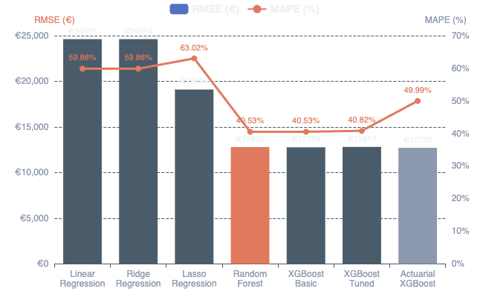
05 • Model Performance
Performance Comparison: RMSE & MAPE Analysis
Winner: Random Forest
Complete Model Comparison
RMSE
€12,802
Root Mean Square Error
MAPE
40.53%
Mean Absolute Percentage Error
Selection Criteria
Selected for lowest MAPE on individual claim predictions—critical for accurate per-policy pricing
MAPE vs RMSE Tradeoff
Lowest RMSE
Lowest MAPE
Performance Gap
MAPE: Best for individual claim accuracy
Actuarial XGBoost: €12,720 (portfolio focus)
Random Forest: 40.53% (individual focus)
19.3% improvement over linear baseline
RMSE: Best for portfolio-level reserves

Slide 10
05 • Model Performance
Why Random Forest Won: Selection Rationale
Selection Criteria
MAPE vs RMSE Tradeoff
Random Forest was selected based on lowest MAPE (Mean Absolute Percentage Error), making it optimal for individual claim predictions where per-policy accuracy is critical.
Random Forest
Best for individual claims
MAPE Focus
RMSE Alternative
MAPE: 40.53%
RMSE: €12,802
Best individual claim accuracy
Better for portfolio reserves
Actuarial XGBoost
Best for portfolio risk
MAPE: 49.99%
RMSE: €12,720
Random Forest Advantages
1
Best Individual Claim Accuracy
Use Case Guidance
Achieves lowest MAPE (40.53%) for precise per-policy predictions, essential for accurate premium pricing
Individual Claims
2
Ensemble Reduces Overfitting
Use Random Forest for per-policy pricing and risk assessment
Multiple decision trees with bagging average out errors, providing robust predictions on unseen data
Portfolio Reserves
3
Handles Mixed Feature Types
Use Actuarial XGBoost for aggregate reserve calculations
Naturally processes both numeric and categorical features without extensive preprocessing
4
Robust to Outliers
Log-transformation of target variable combined with ensemble averaging reduces outlier impact

Slide 11
06 • Production Deployment
MLOps Stack: Hugging Face Hub & Streamlit Cloud
Hugging Face Hub
Streamlit Cloud
The trained model and artifacts are stored on Hugging Face Hub for version control, easy access, and collaboration.
The web app is deployed to Streamlit Cloud with zero infrastructure management, auto-scaling, and a free tier perfect for portfolio projects.
Version Control
Zero Infrastructure
Track model iterations and improvements
No servers to manage or configure
Easy Access
Auto-Scaling
Download artifacts with one line of code
Handles traffic automatically
Collaboration
Free Tier
Share models publicly with the community
Perfect for portfolio projects
Download in Streamlit App
Launch Application
from huggingface_hub import hf_hub_download
model_path = hf_hub_download(
repo_id="user/belgian-mtpl",
filename="model.pkl"
)
cd streamlit_app
pip install -r requirements.txt
streamlit run app.py
Complete Tech Stack
Stored Artifacts
Data & ML
pandas, NumPy, scikit-learn, XGBoost
MLOps
MLflow, Hugging Face Hub, joblib
model.pkl
preprocessor
categories
Deployment
Streamlit, Streamlit Cloud
Trained model
Pipeline
Metadata

Slide 12
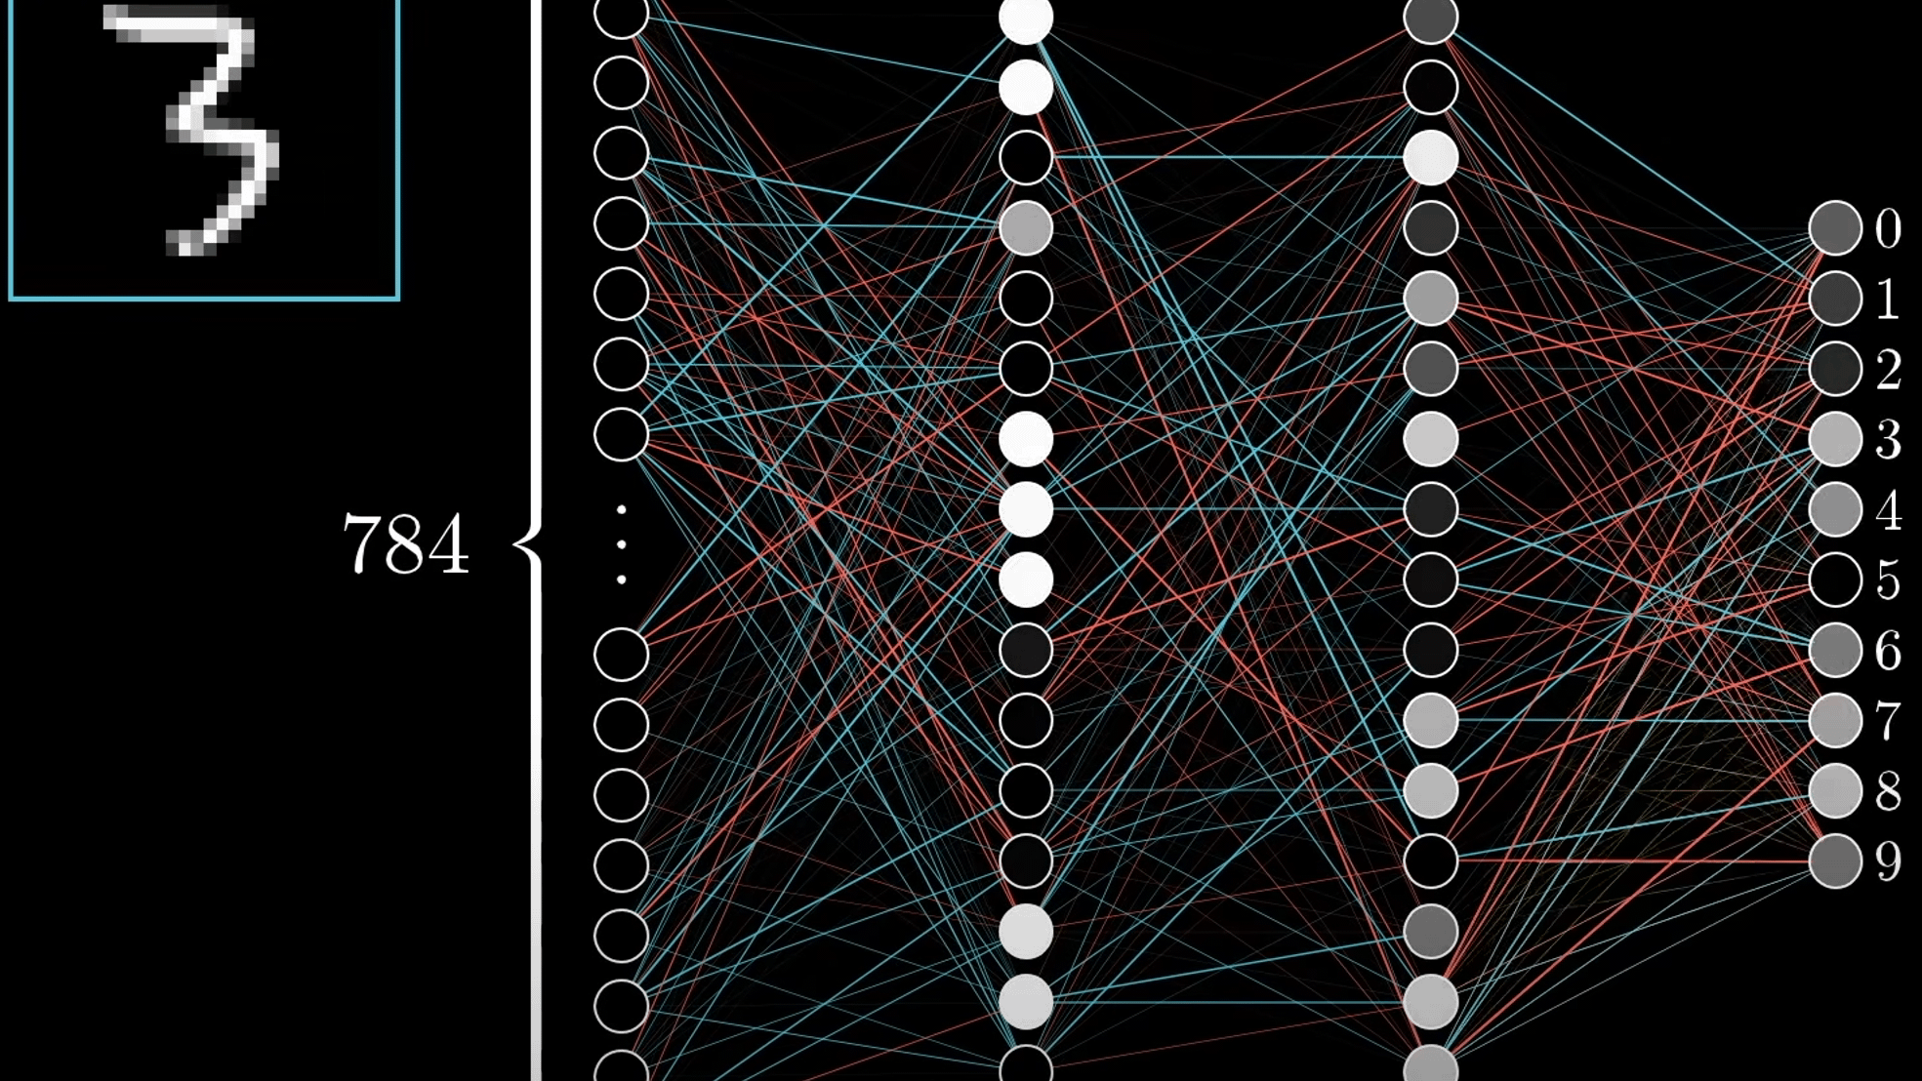
07 • Key Takeaways
Project Learnings & Impact
Technical Skills
Tools & Frameworks
Best Practices
ML Pipeline Design
scikit-learn Pipelines
Reproducibility
Building end-to-end pipelines from data to deployment
Composing preprocessing and modeling steps
All experiments tracked and reproducible
XGBoost
Code Organization
Feature Engineering
Advanced gradient boosting with custom objectives
Modular, well-documented codebase
Creating meaningful features from raw insurance data
Error Handling
MLflow
Robust application with graceful errors
Model Selection
Industry-standard experiment tracking
MAPE vs RMSE tradeoffs for different use cases
Version Control
Hugging Face Hub
Git for code, HF Hub for models
MLOps
Modern model registry and versioning
Experiment tracking and deployment automation
Streamlit
Insurance ML
Rapid prototyping of ML applications
Individual vs portfolio-level predictions
Project Impact
40.53%
7
100%
Complete end-to-end ML pipeline from raw data to production deployment
Lowest MAPE
Models Compared
Reproducible

