Slide 1
Internship Realizations and Updated project Plan
Charles Nana Kwkaye

Slide 2
TABLE of content
Introduction
Assignment Description
The problem
Embeddings
Implementation options
Approach 1,2 and 3
Realizations
Project Deliverables
Update

Slide 3
What is vrt?
Vlaamse Radio- en Televisieomroeporganisatie, is the national public-service broadcaster for the Flemish Community of Belgium.

Slide 4
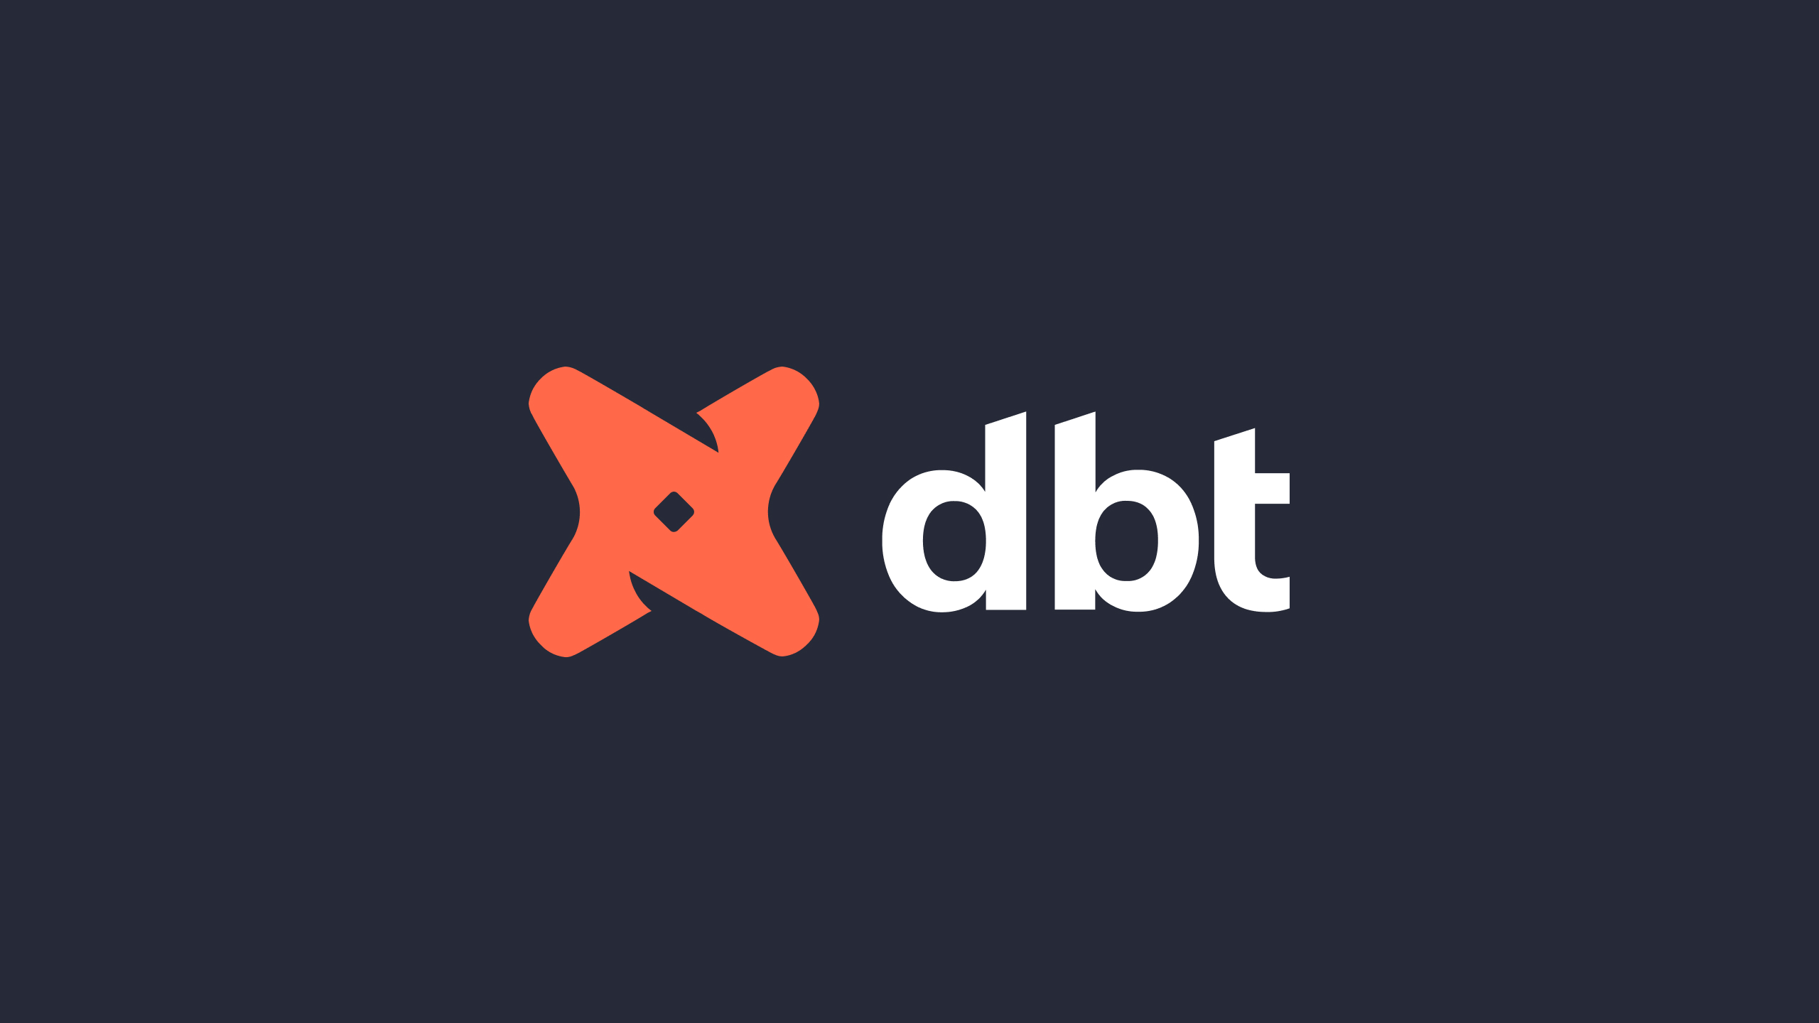
ASSIGNMENT DEScription
DBT is an open-source command line tool specifically designed for data analysts and data engineers. It helps them develop, test, and deploy data transformations in a collaborative and reliable way
This project aims to explore the feasibility of using Large Language Models (LLMs) to document dbt queries and, if feasible, to implement a solution for the VRT data team's specific needs

Slide 5
The problem
Large DBT project
A lot of models, packages and macros
Lack of documentation
Difficult to understand the queries when navigating the project

Slide 6
Implementation Options

Slide 7
What is EMbeddings
Turning complex data (words, images, etc.) into simple lists of numbers.
Like a "secret code" for computers to understand meaning.
Similar things have similar codes, making connections easier.
Example:
[ 0.00049438 0.11941205 0.00522949 ... 0.01687654 -0.02386115 0.00526433]

Slide 8
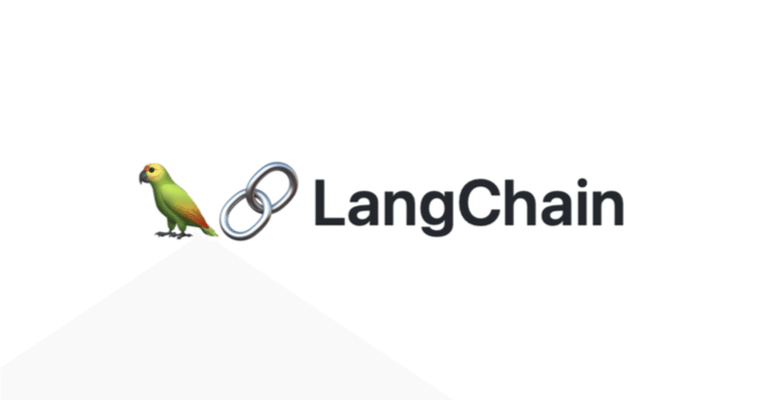
Choosing A LLM FRamework
Tools designed to simplify the development and deployment of applications powered by Large Language Models (LLMs).
Have prebuilt components for prompt templates, indexing, retrieving, output parsing and chaining responses
VS
Langchain | LlamaIndex
General purpose framework for data processing, indexing, and interacting with LLMs | Specifically designed for building search and retrieval applications using LLMs
More flexible, allowing for customization of application behavior and chaining of complex LLM prompts | Less flexible, but provides a simpler interface for querying LLMs and retrieving documents.
Has documentation of similar use cases | Does not have documentation of similar use cases

Slide 9
Difference Between APPROACHES
Prompt based approach
Embeddings
Fine tuning
Approach | Key-feature |  | Additional Requirements
Prompt-Based | Simple prompts to LLM |  | None
Embeddings | Embeds queries and metadata |  | Vector databse, Embedding model
Fine-tuning | Directly trains LLM on dbt queries |  | Large dataset with some documentation of dbt queries required for training

Slide 10
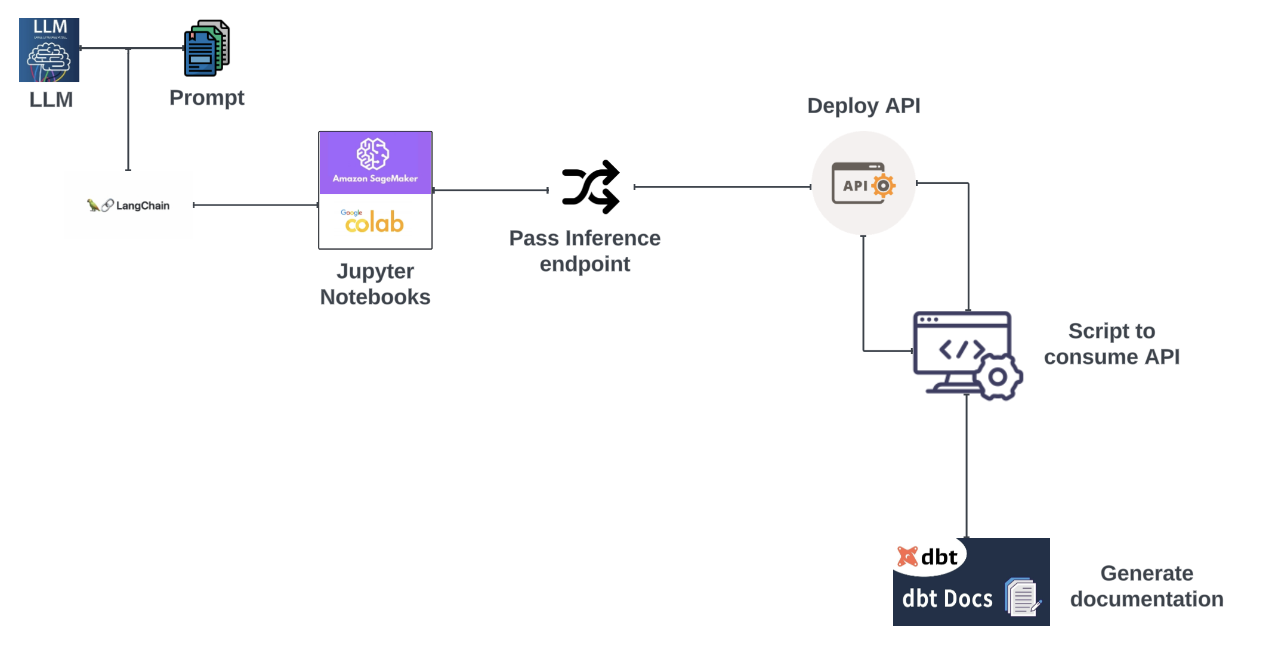
APPROACH 1
PROMPT BASED
Reason to choose
Simplicity: Straightforward and mininmal infrastructure or coding
Flexibilty: Easily modify prompts for different dbt query types and documentation style

Slide 11
rEalization FOR Approach 1
LLM Documentation Generation Incomplete: Query Length Exceeded Token Limit
Documentation improvement relies heavily on quality of prompts
No data retention as queries are passed to model as prompts

Slide 12
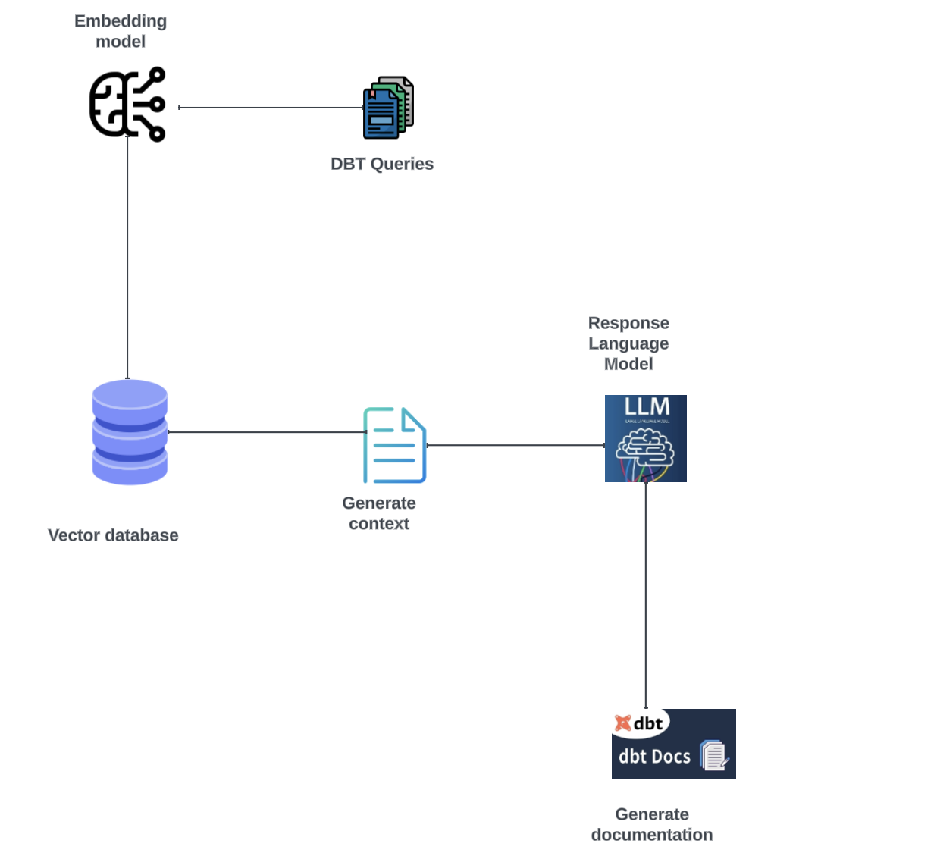
APPROACH 2
USING EMBEDDINGS
Reason to choose
Improved context: Capture semantic meanings of queries and it metadta. Leads to richer documentation`
Reusability: Redocument queries easily if documentation not up to par
Scalabity: Can handle large dbt datasets more efficiently

Slide 13
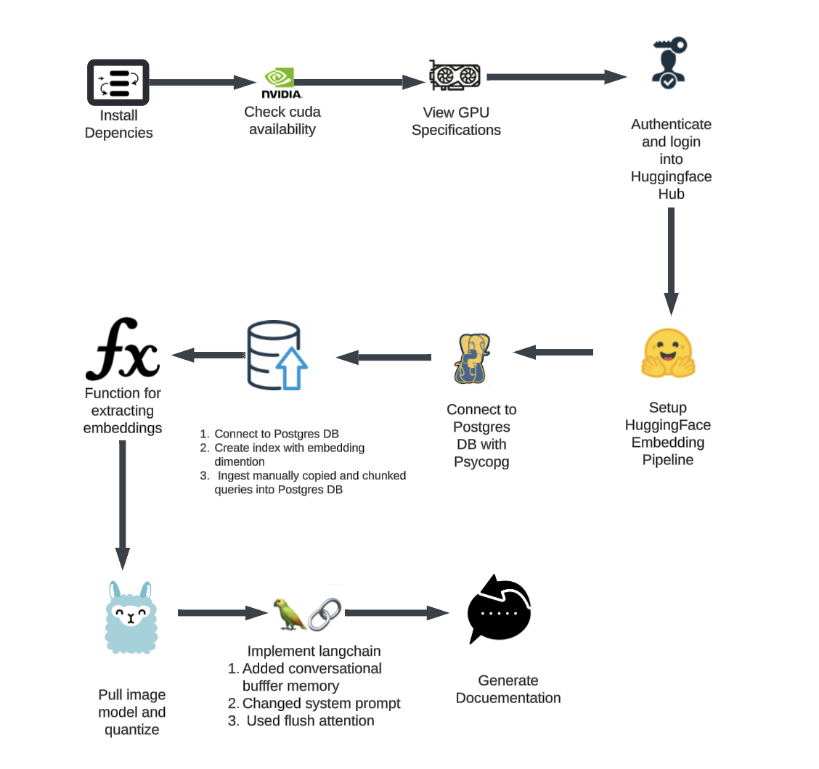
APPROACH 2 NOTEBOOK WORKFLOW

Slide 14
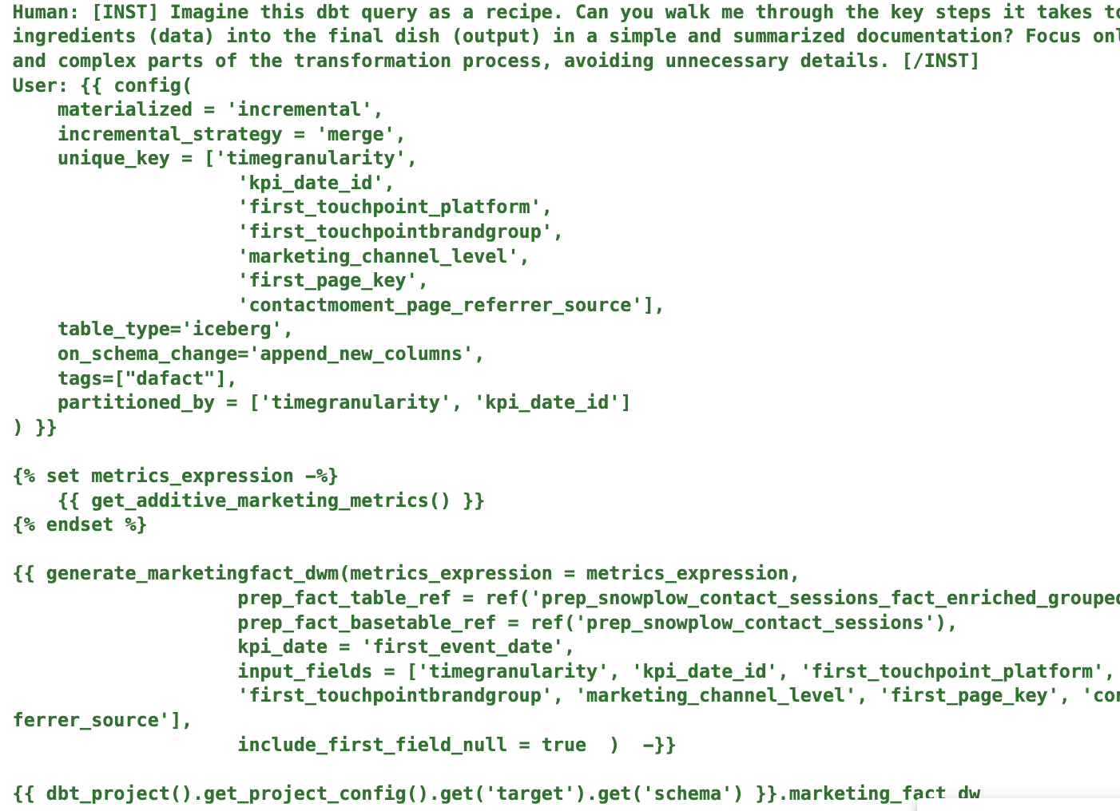
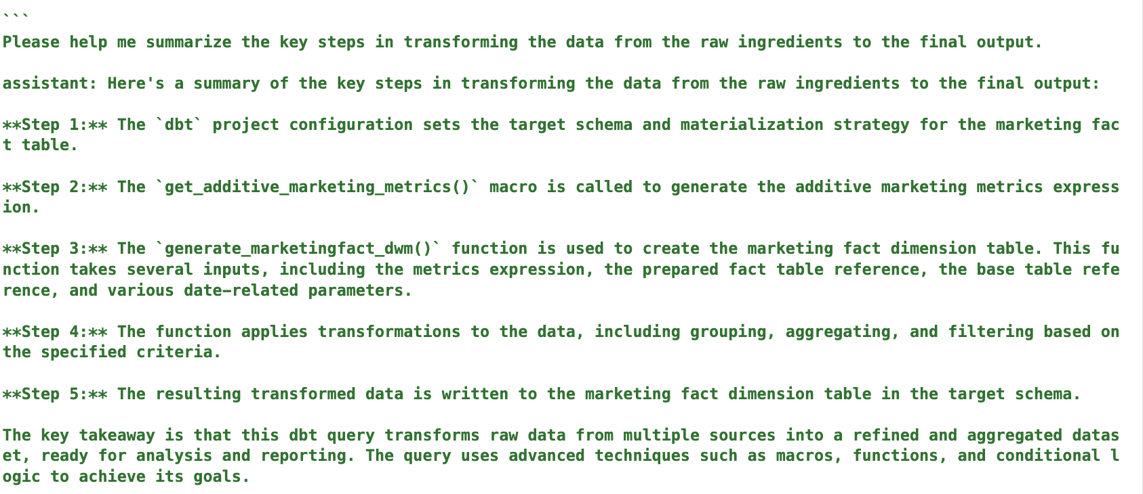
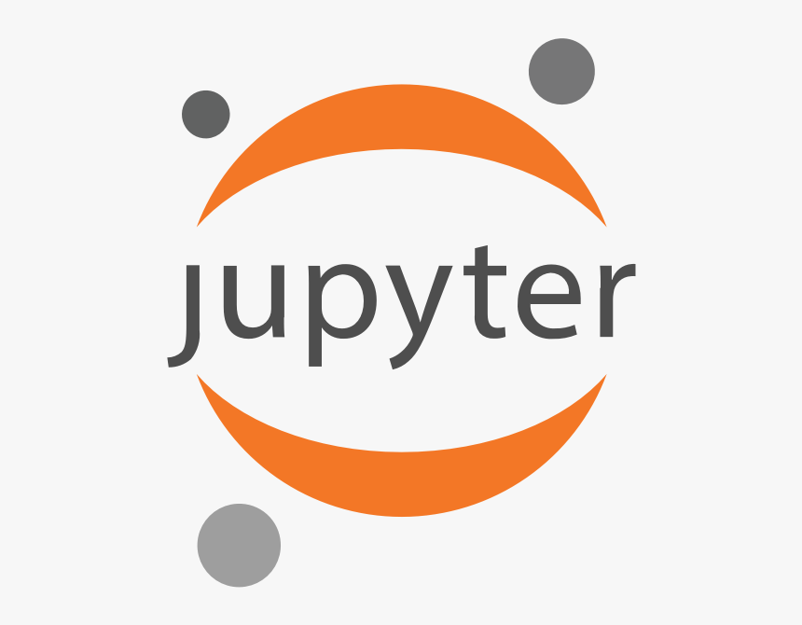
After System prompt and json style Response
PROMPT
RESPONSE
Link to notebook for live demo ⬇️

Slide 15
Why StILL USE EMBEDDINGS WHEN THE FULL CODE IS STILL PASSED TO THE MODEL?
Model can be reprompted to generate new documentation for engineer if not satisfied with already existing documentation
Notebook template could be expanded to explain a models dependecy based on another

Slide 16
REALIZATION FOR Approach 2
LLM Documentation Generation Incomplete: Query Length Exceeded Token Limit
Documentation improvement relies heavily on quality of prompts
Has conversational buffer memory so it can be prompted in a series
Larger context as LLama 3 is used instead of Llama 2
Difficult to choose a well balance embedding model

Slide 17
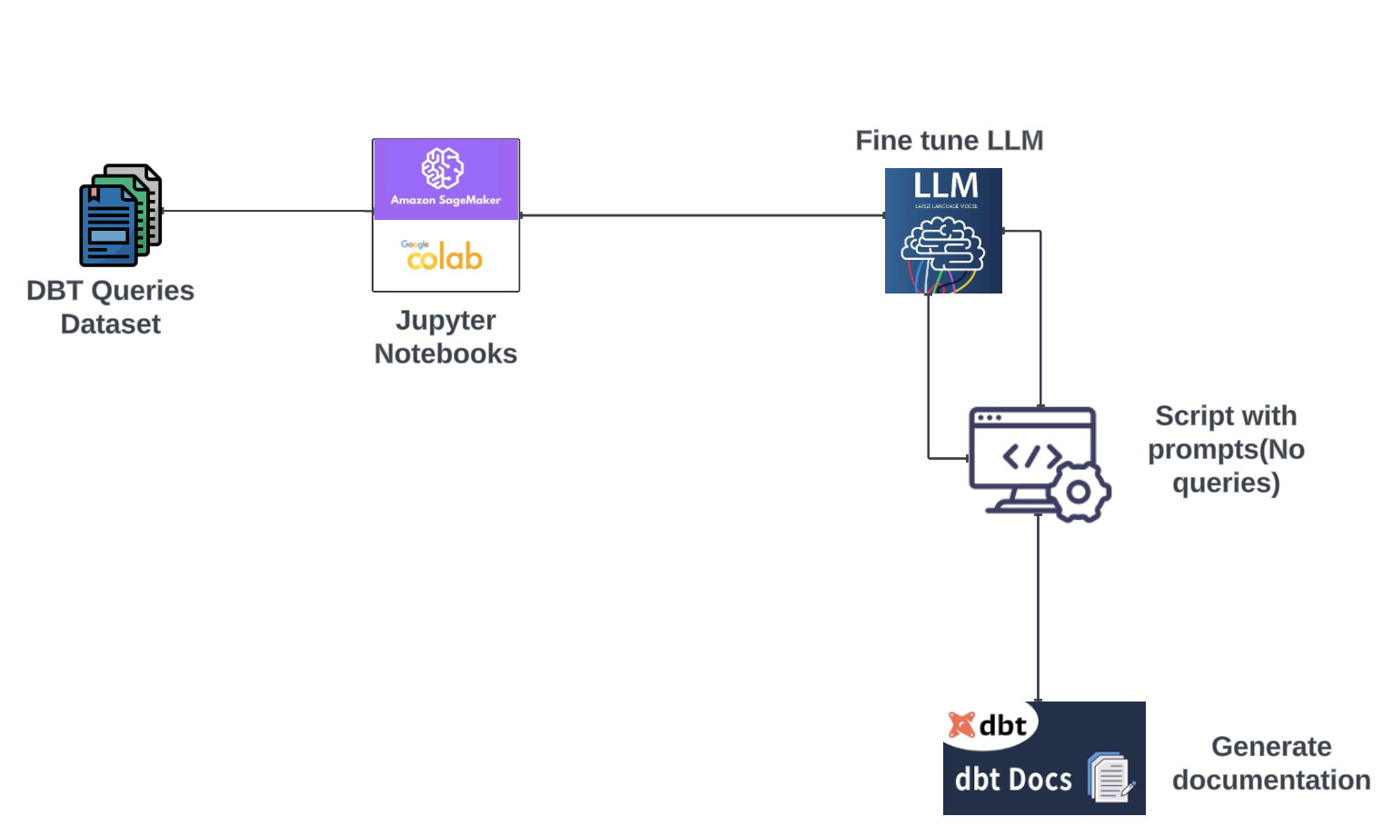
APPROACH 3
FINE TUNING LARGE LANGUAGE MODEL
Reason to choose
Anticipated to be the highest accurate: Fine tunnig enhances models undertanding of the domain and improves documentation accuracy

Slide 18
ANTiCIPATION FOR Approach 3
Data preparation for fine-tuning would be time-consuming and complex.
Would be difficult to maintain and update the fine-tuned model as dbt queries evolve. (Overfitting and loss of interpretability)

Slide 19
ProJect Deliverables

Slide 20
Project Deliverables
2 or more word documents or PDFs with my findings, trials and how to use certain functionalities
3 Jupyter notebooks with one for each implementation option (2 now)

Slide 21
Pros and CONS of each approach
Approach 1: Prompt-Based LLM
Approach 2: Embeddings
Approach 3: Fine-Tuning LLM
Pros: Simple, straightforward, flexible, minimal infrastructure
Cons: Limited context, potential for inaccurate documentation.
Pros:
Improved context, better understanding of data structure due to prompting series, scalable.
Regenerate documentation tailored for each engineer due to already stored embeddings
Cons: Requires additional infrastructure (vector database), computationally expensive.
Pros: Highest accuracy, specifically tailored to dbt queries
Cons: Resource-intensive, limited adaptability to changes.

Slide 22
UpDATED TIMELINE

Slide 23
TODOS
Realization for approach 2
Realization for approach 3
Fine tune LLM for approach 3
Generate context when quering vector DB
Make powerpoint about the report
Finish cleaning and organizing report
Deploy inference endpoint for approach 1

Slide 24
Thank you
Charles Nana Kwakye

